Slide 1

Welcome to St Michael’s
29th Sunday in Ordinary Time Year C
Mission Sunday
Please ensure all mobile phones are switched off.
Please be respectfully quiet as we prepare for our Celebration.
Notes:
Saturday 5.30PM First Sunday of Advent
7am - 22nd Sunday in Ordinary Time

Slide 2
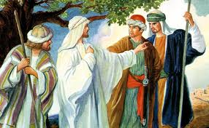
Jesus told his disciples a parable about the need to pray continually and never lose heart.

Slide 3
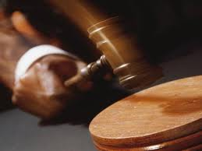
There was a judge in a certain town’, with neither respect for God or people..

Slide 4
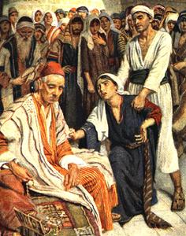
In the same town there was a widow who kept coming to him and saying, “I want justice from you…”

Slide 5
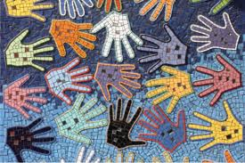
Have you ever raised your voice for the cause of justice? Has area of need or justice project ever caught your attention?

Slide 6
PLEASE STAND

Slide 8
Glory to God in the highest,
and on earth peace to people of good will. We praise you, we bless you,
we adore you, we glorify you,

Slide 9
we give you thanks for your great glory,
Lord God, heavenly King,
O God, almighty Father.

Slide 10
Lord Jesus Christ, Only Begotten Son,
Lord God, Lamb of God, Son of the Father,

Slide 11
you take away the sins of the world, have mercy on us;
you take away the sins of the world, receive our prayer;

Slide 12
you are seated at the right hand of the Father,
have mercy on us.

Slide 13
For you alone are the Holy One,
you alone are the Lord, you alone are the Most High, Jesus Christ, with the Holy Spirit, in the glory of God the Father. Amen.

Slide 15
RESPONSORIAL PSALM
Our help is from the Lord,
who made heaven and earth.

Slide 17
GOSPEL ACCLAMATION
Alleluia, alleluia!
The word of God is living and active; it probes the thoughts and motives of our heart.
Alleluia!

Slide 19
Apostles Creed
I believe in God,
the Father almighty,
Creator of heaven and earth,
and in Jesus Christ, his only Son, our Lord,
(At the words that follow, up to and including the Virgin Mary, all bow.)

Slide 20
who was conceived by the Holy Spirit,
born of the Virgin Mary,
suffered under Pontius Pilate,
was crucified, died and was buried;
he descended into hell;

Slide 21
on the third day he rose again from the dead;
he ascended into heaven,
and is seated at the right hand of God the Father almighty;
from there he will come to judge the living and the dead.

Slide 22
I believe in the Holy Spirit,
the holy catholic Church,
the communion of saints, the forgiveness of sins,
the resurrection of the body, and life everlasting. Amen.

Slide 24
First Collection
This collection goes to the Bishop
for the support of the Diocese.
Thank you for your contribution

Slide 26
All: May the Lord accept the sacrifice
at your hands for the praise and glory of his name, for our good and the good of all his holy Church.

Slide 28
HOLY, HOLY, HOLY
Holy, Holy, Holy Lord God of hosts,
Heaven and earth are full of your glory. Hosanna in the highest
Blessed is he who comes
in the name of Lord,
Hosanna in the highest.

Slide 30
Save us, Saviour of the world,
for by your Cross and Resurrection
you have set us free.
Memorial Acclamation
When we eat this Bread
and drink this Cup,
we proclaim your Death, O Lord,
until you come again.
We proclaim your Death, O Lord,
and profess your Resurrection
until you come again.
Notes:
Sunday 10AM First Sunday of Advent
7am - 14th Sunday in Ord Time
7am - 14th Sunday in Ord Time

Slide 32
Lamb of God
Lamb of God, you take away the sins of the world, have mercy on us.
Lamb of God, you take away the sins of the world, have mercy on us.
Lamb of God, you take away the sins of the world, grant us peace.

Slide 34
All: Lord, I am not worthy
that you should enter under my roof, but only say the word
and my soul shall be healed.

Slide 35


Slide 37
Second Collection
What you contribute now
is for the support of our
parish and its mission.
Thank you for your generosity

Slide 38
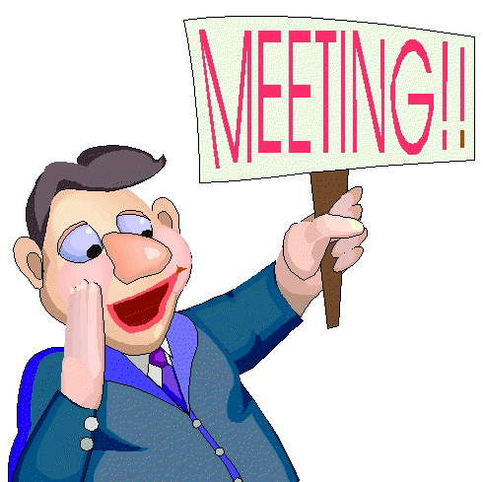
PPC MEETING
(Parish Pastoral Council)
Tuesday 22 October 7.30PM
Parish Centre
All Welcome!

Slide 39
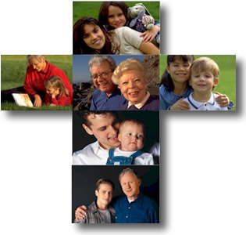
Formation Opportunities
Liturgical Ministries
Tuesday 29 October 2013
7.30pm St Michael’s Parish Centre
Sunday 24 November 2013
2.00 pm Institute for Mission
RSVP – Parish Office

Slide 40

NOVEMBER MASS OFFERINGS
Names recorded in Book of Remembrance and remembered at all Masses during November.

Slide 41

The SVDP pantry needs to restock the following items:
Pasta Sauce; Tinned Fruit; Tinned Meat (Corned Beef/Ham) Tinned Spaghetti and Biscuits.
Many thanks for your support

Slide 42

Please take home your bulletins or download it from
www.stmichaelsparish.com
  www.facebook.com/
  blacktowncatholics

Slide 44
Have you ever raised your voice for the cause of justice? Has area of need or justice project ever caught your attention?

